Slide 1
Stack and Queue

Slide 2
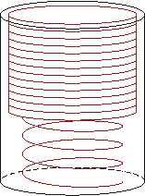
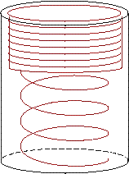
Introduction to Stacks
A stack is a last-in-first-out (LIFO) data structure
Adding an item
  Referred to as pushing it onto the stack
Removing an item
  Referred to as
  popping it from
  the stack

Slide 3
A Stack
Definition:
  An ordered collection of data items
  Can be accessed at only one end (the top)
Operations:
  construct a stack (usually empty)
  check if it is empty
  Push: add an element to the top
  Top: retrieve the top element
  Pop: remove the top element

Slide 4
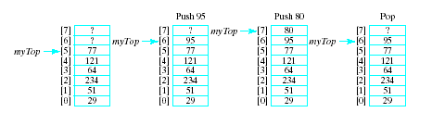
Selecting Storage Structure
Position 0 is the bottom of the stack
Our design includes:
  An array to hold the stack elements
  An integer to indicate the top of the stack

Slide 5
Implementing Operations
Empty
  Check if value of myTop == -1
Push (if myArray not full)
  Increment myTop by 1
  Store value in myArray[myTop]
Top
  If stack not empty, return myArray[myTop]
Pop
  If array not empty, decrement myTop
Output routine added for testing

Slide 6
STACKS
Algorithm: STACK_PUSH
MAXSTK is the maximum limit of STACK, ITEM is the element to insert into the STACK
PUSH(STACK,TOP,MAXSTK,ITEM)
1.[Stack already filled]
If TOP=MAXSTK, then
Write: OVERFLOW and Return
[end of if structure]
2. Set TOP:=TOP+1 [increases TOP by 1]
3. Set STACK[TOP]:=ITEM [insert ITEM in new TOP position]
4. Return

Slide 7
Algorithm: STACK_POP
POP(STACK,TOP,ITEM)
1.[Stack has an item to be removed]
If TOP=0, then
Write: UNDERFLOW and Return
[end of if structure]
2. Set ITEM:=STACK[TOP] [Assigns TOP element to ITEM]
3. Set TOP:=TOP-1 [Decreases TOP by 1]
4. Return

Slide 8
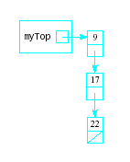
Linked Stacks
Another alternative to allowing stacks to grow as needed
Linked list stack needs only one data member
  Pointer myTop
  Nodes allocated (but not
  part of stack class)

Slide 9
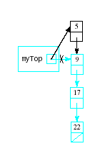
Implementing Linked Stack Operations
Empty
  Check for myTop == null
Push
  Insertion at beginning of list
Top
  Return data to which myTop
  points

Slide 10
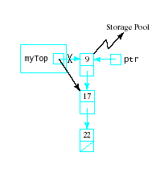
Implementing Linked Stack Operations
Pop
  Delete first node in the
  linked list
  ptr = myTop;
  myTop = myTop->next;
  delete ptr;
Output
  Traverse the list
  for (ptr = myTop; ptr != 0; ptr = ptr->next)
  cout << ptr->data << endl;

Slide 11
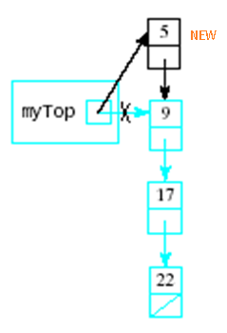
Linked Representation of stack
PROCEDURE: STACK_PUSH_LL
This procedure pushes an ITEM into a linked stack
PUSH_LINKSTACK(INFO,LINK,TOP,AVAIL,ITEM)
1. [Available Space?]
if AVAIL==NULL , then
Write: OVERFLOW and EXIT
[end of if structure]
2. [Remove first node from the avail list]
Set NEW = AVAIL and AVAIL = AVAIL→link
3. Set NEW→info = ITEM [copies ITEM into new node]
4.Set NEW→link = TOP [new node points to the original top node in stack]
5.Set TOP=NEW [reset TOP to point to new node at the top of stack]
6.Exit

Slide 12
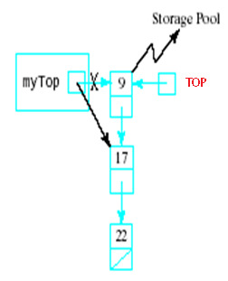
PROCEDURE: STACK_POP_LL
This procedure deletes the top element an ITEM into a
linked stack and assign it to the variable ITEM
POP_LINKSTACK(INFO,LINK,TOP,AVAIL,ITEM)
1. [Stack has an item to be removed?]
If TOP==NULL , then
Write: UNDERFLOW and EXIT
[End of if structure]
2. Set ITEM = TOP→info [copies the top element of stack into ITEM]
3. Set TEMP = TOP and TOP = TOP→link
[Remember the old value of the TOP pointer in TEMP and reset TOP to point to the next element in the stack]
4. Set TEMP→link = AVAIL [Return deleted node to the AVAIL list]
5. Set Avail = TEMP
6. Exit

Slide 13
QUEUE

Slide 14
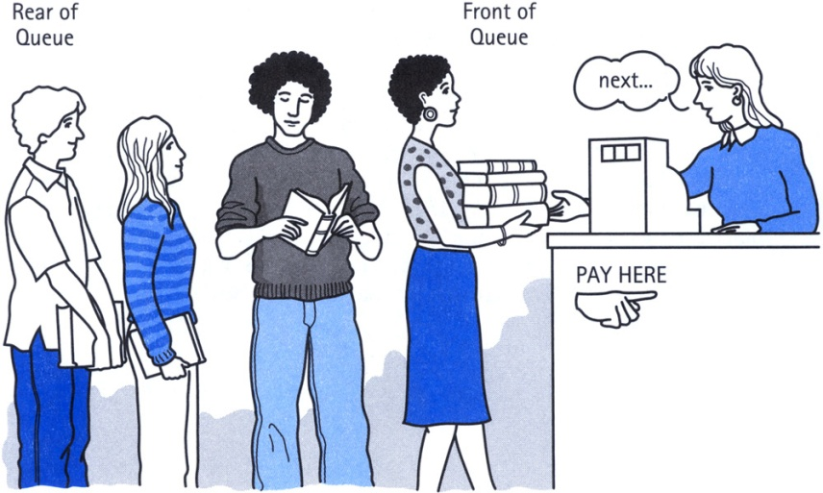
Definition of Queue
A Queue is an ordered collection of items from which items may be deleted at one end (called the front of the queue) and into which items may be inserted at the other end (the rear of the queue).
The first element inserted into the queue is the first element to be removed. For this reason a queue is sometimes called a FIFO (first-in first-out) list as opposed to the stack, which is a LIFO (last-in first-out).

Slide 15
Queue
A new item (A) is inserted at the Rear of the queue
1
2
3
4
5
6
7
Front = 0
Rear = 0
A
1
2
3
4
5
6
7
Front
Rear

Slide 16
A new item (B) is inserted at the Rear of the queue
A | B
1
2
3
4
5
6
7
Front
Rear

Slide 17
A new item (C) is inserted at the Rear of the queue
A | B | C
1
2
3
4
5
6
7
Front
Rear

Slide 18
A new item (D) is inserted at the Rear of the queue
A | B | C | D
1
2
3
4
5
6
7
Front
Rear

Slide 19
QINSERT(QUEUE,N,FRONT,REAR,ITEM)
This procedure inserts an element ITEM into a queue
1) [queue already filled?]
If FRONT = 1 and REAR = N , or if FRONT = REAR+1, then
Write: OVERFLOW and return
2) [find new value of REAR]
If FRONT = 0 [if queue initially empty]
Set FRONT := 1 and REAR := 1
Else if REAR = N , then [if Rear is pointing at end of array]
Set REAR := 1
Else:
Set REAR := REAR+1
[end of if structure]
3) Set QUEUE[REAR] := ITEM [this inserts new element]
4) RETURN
A | B | C | D
1
2
3
4
5
6
7
Front
Rear

Slide 20
Insertion [Linked list representation]
If AVAIL==NULL then
Write: OVERFLOW and EXIT
[end of if structure]
2. Set NEW = AVAIL and AVAIL = AVAIL→link
3. Set NEW→info = ITEM and NEW→link = NULL
If FRONT==NULL then [then queue initially empty]
FRONT=REAR=NEW
else
Set REAR→link = NEW and REAR=NEW
[end of if structure]
5. Exit

Slide 21
Delete A
An item (A) is deleted from the Front of the queue
A | B | C | D
1
2
3
4
5
6
7
Front
Rear
 | B | C | D
1
2
3
4
5
6
7
Front
Rear

Slide 22
Delete B
An item (B) is deleted from the Front of the queue.
 | B | C | D
1
2
3
4
5
6
7
Front
Rear
 |  | C | D
1
2
3
4
5
6
7
Front
Rear

Slide 23
Delete B
An item (C) is deleted from the Front of the queue.
 |  | C | D
1
2
3
4
5
6
7
Front
Rear
 |  |  | D
1
2
3
4
5
6
7
Front
Rear

Slide 24
Delete B
An item (D) is deleted from the Front of the queue.
 |  |  | D
1
2
3
4
5
6
7
Front
Rear
1
2
3
4
5
6
7
Front = 0
Rear = 0

Slide 25
QDELETE(QUEUE,N,FRONT,REAR,ITEM)
This procedure deletes an element from a queue and assign it to the variable item
1) [queue already empty?]
If FRONT = 0 Then
Write: UNDERFLOW and return
[end of if structure]
2) Set ITEM := QUEUE[FRONT]
3) [find new value of FRONT]
if FRONT=REAR , then: [queue has only one element]
Set FRONT := 0 and REAR := 0
else if FRONT=N, then [if Front is pointing at end of array]
Set FRONT := 1
else
Set FRONT := FRONT+1
[end of if structure]
4) RETURN

Slide 26
Deletion [Linked list representation]
If FRONT==NULL then
Write: UNDERFLOW and EXIT
[end of if structure]
2. Set TEMP = FRONT
ITEM = TEMP→info
If FRONT == REAR [queue has only one element]
Front = NULL and Rear = NULL
else
Front = Front→link
[end of if structure]
5. TEMP→link = AVAIL and AVAIL = TEMP
6. Exit

Slide 27
Deque (Double-ended queue)
It is a double-ended queue.
Items can be inserted and deleted from either ends.
More versatile data structure than stack or queue.
E.g. policy-based application (e.g. low priority go to the end, high go to the front)
Left = 4
Right = 7
 |  |  | AAA | BBB | CCC | DDD
1 | 2 | 3 | 4 | 5 | 6 | 7 | 8
Left = 7
Right = 2
YYY | ZZZ |  |  |  |  | WWW | XXX
1 | 2 | 3 | 4 | 5 | 6 | 7 | 8

Slide 28
Priority Queue
More specialized data structure.
Similar to Queue, having front and rear.
Items are removed from the front.
Items are ordered by key value so that the item with the lowest key (or highest) is always at the front.
  Two elements with same priority are processed according to order in which they were added to queue.
Items are inserted in proper position to maintain the order.

Slide 29
It can be maintained in memory by means of one-way list as:
  Each node will contain 3 items → info, priority_no & link
  A node X precedes a node Y in list when,
    X has higher priority than Y
    Both have same priority but X was added to list before Y

Slide 30
Polish (Prefix) Notation

Slide 31
Arithmetic Expressions
Arithmetic Expressions involve constants and operations.
Binary operations have different levels of precedence.
  First : Exponentiation (^)
  Second: Multiplication (*) and Division (/)
  Third : Addition (+) and Subtraction (-)

Slide 32
Example
Evaluate the following Arithmetic Expression:
5 ^ 2 + 3 * 5 – 6 * 2 / 3 + 24 / 3 + 3
First:
  25 + 3 * 5 – 6 * 2 / 3 + 24 / 3 + 3
  Second:
  25 + 15 – 4 + 8 + 3
  Third:
  47

Slide 33
Infix Notation
Infix Notation: Operator symbol is placed between the two operands.
Example:
(5 * 3) + 2 & 5 * (3 + 2)

Slide 34
Polish (Prefix) Notation

Slide 35
Prefix / Polish Notation
Polish Notation: The Operator Symbol is placed before its two operands.
Example: + A B, * C D, / P Q etc.
In prefix notation you put the operator first followed by the things it acts on and enclose the whole lot in brackets.
So for example if you want to write 3+4, in scheme you say: (+ 3 4)

Slide 36
Examples
(A + B) * C =
* + ABC
A + (B * C) =
+ A *BC
(A + B) / (C - D) =
/ +AB –CD
Also Known as Prefix Notation.

Slide 37
Advantage of Prefix notation
The advantage of the prefix notation is that no operator precedence is required; the bracketing shows what the operator acts on.
So in scheme if you want 3*4+2, you say : (+ (* 3 4) 2)
And if you want 3*(4+2), you write: (* 3 (+ 4 2))
So in scheme, you don’t need operator precedence, but you do need lots of brackets.

Slide 38
Reverse-Polish (Postfix) Notation

Slide 39
Reverse-Polish / Postfix Notation
Reverse Polish Notation: The Operator Symbol is placed after its two operands.
Example: A B+, C D*, P Q/ etc.
Also known as Postfix Notation.

Slide 40
Postfix and Prefix Examples
INFIX POSTFIX PREFIX
A + B
A * B + C
A * (B + C)
A - (B - (C - D))
A - B - C - D
A B +
+ A B
A B * C +
+ * A B C
A B C + *
* A + B C
A B C D---
-A-B-C D
A B-C-D-
---A B C D
Prefix : Operators come before the operands

Slide 41
Advantage of Postfix notation
You can easily evaluate a postfix expression in a single scan from left to right with the help of a stack (unlike evaluating infix expressions).
There is no need of the concept of parentheses and precedence rules etc. in a postfix expression.

Slide 42
Transforming Infix into Postfix

Slide 43
Transforming Infix into Postfix
By hand: "Fully parenthesize-move-erase" method:
1. Fully parenthesize the expression.
2. Replace each right parenthesis by the corresponding operator.
3. Erase all left parentheses.
Examples:
A * B + C →
((A * B) + C)
A * (B + C) →
(A * (B + C) )
→ ((A B * C +
→ A B * C +
→ (A (B C + *
→ A B C + *

Slide 44
Infix to Postfix Transformation (Algo.)
Algorithm: POLISH (Q, P)
Suppose Q is an arithmetic expression written in infix notation.
This algorithm finds the equivalent postfix expression P.
PUSH “(” on to STACK and add “)” to the end of Q.
Scan Q from left to right and Repeat steps 3 to 6 for each element of Q until the STACK is empty:
If an operand is encountered, add it to P. [End of If structure.]
If a left parenthesis is encountered, push it onto STACK. [End of If structure.]
If an operator is encountered, then:
(a) Repeatedly POP from STACK and add to P each operator (On the TOP of STACK) which has the same precedence as or higher precedence than @.
(b) Add @ to STACK.
[End of If structure.]
If a right parenthesis is encountered, then:
(a) Repeatedly POP from STACK and add to P each operator (On the TOP of STACK.) until a left parenthesis is encountered.
(b) Remove the left parenthesis. [Don’t add the left parenthesis to P.]
[End of If Structure.]
[End of step 2 Loop.]
7. Exit.

Slide 45
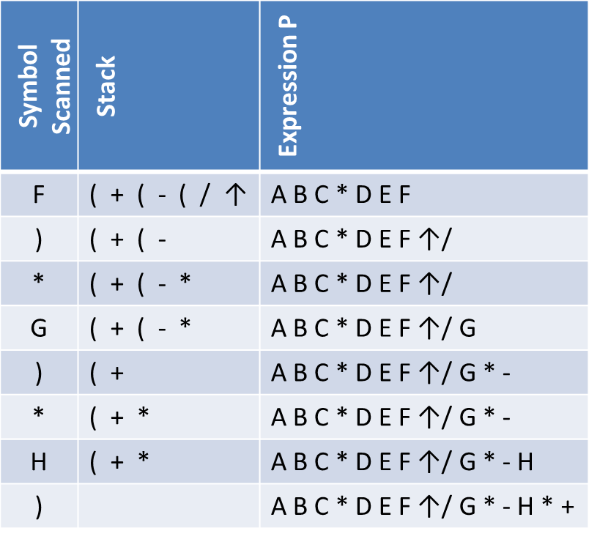
Infix to Postfix
A + ( B * C – ( D / E ↑ F ) * G ) * H
Symbol Scanned | Stack | Expression P
A | ( | A
+ | ( + | A
( | ( + ( | A
B | ( + ( | A B
* | ( + ( * | A B
C | ( + ( * | A B C
- | ( + ( - | A B C *
( | ( + ( - ( | A B C *
D | ( + ( - ( | A B C * D
/ | ( + ( - ( / | A B C * D
E | ( + ( - ( / | A B C * D E
↑ | ( + ( - ( / ↑ | A B C * D E
A + ( B * C – ( D / E ↑ F ) * G ) * H )

Slide 46
Evaluating Postfix (RPN) Expressions

Slide 47
Evaluating Postfix (RPN) Expressions
"By hand" (Underlining technique):
1. Scan the expression from left to right to find an operator.
2. Locate ("underline") the last two preceding operands
and combine them using this operator.
3. Repeat until the end of the expression is reached.
Example:
2 3 4 + 5 6 - - *
→ 2 3 4 + 5 6 - - *
→ 2 7 5 6 - - *
→ 2 7 5 6 - - *
→ 2 7 -1 - *
→ 2 7 -1 - * →
2 8 * →
16
2 8 * →

Slide 48
Evaluation of Postfix (RPN) Expression (Algo.)
P is an arithmetic expression in Postfix Notation.
Add a right parenthesis “)” at the end of P.
Scan P from left to right and Repeat Step 3 and 4 for each element of P until the sentinel “)” is encountered.
If an operand is encountered, put it on STACK.
If an operator @ is encountered, then:
(a) Remove the two top elements of STACK, where A is the top element and B is the next to top element.
(b) Evaluate B @ A.
(c) Place the result of (B) back on STACK.
[End of if structure.]
[End of step 2 Loop.]
Set VALUE equal to the top element on STACK.
Exit.

Slide 49
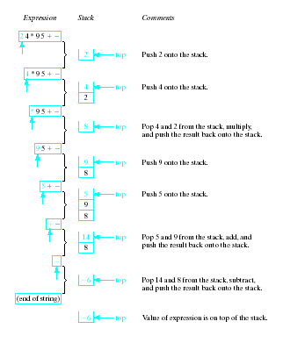
Evaluating
RPN
Expressions

Slide 50
Quick Sort

Slide 51
Quick Sort
It is an algorithm of divide and conquer.
After reduction step, final position of no. is:
44, 33, 11, 55, 77, 90, 40, 60, 99, 22, 88, 66
22, 33, 11, 40, 44, 90, 77, 60, 99, 55, 88, 66
First sublist
Second sublist

Slide 52
Iterative procedure

Slide 53
The algorithm begins by pushing boundary values 1 and 12 onto stack to yield
To apply reduction step, top values are removed from stack, leaving
And then reduction step is applied to list from A[1] to A[12]. Finally 44 reaches its final location A[5].
Accordingly, algo. Pushes boundary values 1 and 4 to 1st sublist and 6 and 12 to 2nd sublist onto stack, leaving
Now, apply reduction step again by removing top values from stack, leaving
Then reduction step is applied to sublist A[6] to A[12], and so on.
Lower: 1 Upper: 12
Lower: (empty) Upper: (empty)
Lower: 1, 6 Upper: 4, 12
Lower: 1 Upper: 4
Lower: 1, 6 Upper: 4, 10

Slide 54
Quick sort algorithm
QUICK(A, N, BEG, END, LOC)
[Initialize] Set LEFT = BEG, RIGHT=END, LOC=BEG
[Scan from right to left]
  Repeat while A[LOC] <=A[RIGHT] and LOC != RIGHT
    RIGHT = RIGHT-1
  If LOC = RIGHT then return
  If A[LOC] > A[RIGHT] then
    [Interchange A[LOC] and A[RIGHT] ] Temp = A[LOC], A[LOC] = A[RIGHT], A[RIGHT] = Temp
    Set LOC = RIGHT
    Go to step 3.
[Scan from left to right]
  Repeat while A[LEFT] <=A[LOC] and LEFT != LOC
    LEFT = LEFT+1
  If LOC = LEFT then return
  If A[LEFT] > A[LOC] then
    [Interchange A[LEFT] and A[LOC] ] Temp = A[LOC], A[LOC] = A[LEFT], A[LEFT] = Temp
    Set LOC = LEFT
    Go to step 2.

Slide 55
Quick sort algorithm
QUICKSORT()
[Initialize] TOP = 0
[Push boundary value of A onto stacks when A has 2 or more elements] If N >1 then TOP = TOP + 1, LOWER[1] = 1, UPPER[1] = N
Repeat steps 4 to 7 while TOP != 0
[Pop sublist from stacks]
  Set BEG = LOWER[TOP] , END = UPPER[TOP]
  TOP = TOP – 1
Call QUICK(A, N, BEG, END, LOC)
[ Push left sublist onto stacks when it has 2 or more elements]
  If BEG < LOC-1 then
    TOP = TOP + 1, LOWER[TOP] = BEG, UPPER[TOP] = LOC-1
[ Push right sublist onto stacks when it has 2 or more elements]
  If LOC+1 < END then
    TOP = TOP+1, LOWER[TOP] = LOC + 1, UPPER[TOP] = END
Exit.

Slide 56
Recursive procedure

Slide 57


Slide 58

Recursive Algorithm
QUICKSORT(A, p, r)
1. if p < r
2. q = PARTITION(A, p, r)
3. QUICKSORT(A, p, q-1)
4. QUICKSORT(A, q +1, r)
[End of if]
5. Exit
q
http://me.dt.in.th/page/Quicksort/

Slide 59
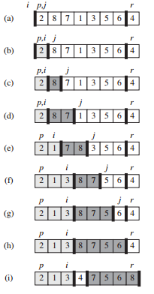
Recursive Algorithm(partitioning)
PARTITION(A, p, r)
1. x = A[r]
2. i = p-1
3. for j = p to r – 1
4. if A[j] <= x
5. i = i+1
6. exchange A[i] with A[j]
[End of if statement]
[End of for loop]
7. exchange A[i+1] with A[r]
8. return i + 1
Partitioning steps by assuming rightmost element as pivot
Purpose of “i” is to interchange first scanned value in window with the value at “j” if value at “j” < pivot value

Slide 60
Complexity of Quick Sort
Worst case
  O(n²)
Average case
  O(n log n)

Slide 61
Merge sort

Slide 62
Divide and Conquer
Recursive in structure
  Divide the problem into sub-problems that are similar to the original but smaller in size
  Conquer the sub-problems by solving them recursively. If they are small enough, just solve them in a straightforward manner.
  Combine the solutions to create a solution to the original problem

Slide 63
An Example: Merge Sort
Sorting Problem: Sort a sequence of n elements into non-decreasing order.
Divide: Divide the n-element sequence to be sorted into two subsequences of n/2 elements each
Conquer: Sort the two subsequences recursively using merge sort.
Combine: Merge the two sorted subsequences to produce the sorted answer.

Slide 65
Merge Sort – Example
18
26
32
6
43
15
9
1
22
26
19
55
37
43
99
2
18
26
32
6
43
15
9
1
22
26
19
55
37
43
99
2
18
26
32
6
43
15
9
1
22
26
19
55
37
43
99
2
18
26
32
6
43
15
9
1
22
26
19
55
37
43
99
2
18
26
32
6
43
15
9
1
22
26
19
55
37
43
99
2

Slide 66
Merge Sort – Example
Original Sequence
Sorted Sequence
18
26
32
6
43
15
9
1
18
26
32
6
43
15
9
1
1
6
9
15
18
26
32
43
Divide
18
26
32
6
43
15
9
1
18
26
32
6
43
15
9
1
6
26
32
6
18
26
32
18
1
9
15
43
1
9
15
43
Divide
Divide
18
26
43
15
9
1
18
26
32
6
43
15
9
1
32
6
18
26
6
32
15
43
18
26
6
32
15
43
1
9
1
9
18
26
32
15
1
15
18
26
32
6
43
15
9
1
18
26
6
43
9
26
32
6
43
15
9
9
1
18
32
6
43
1
18
26
32
6
43
15
9
1
18
26
32
6
43
15
9
1
Conquer/Merge

Slide 67
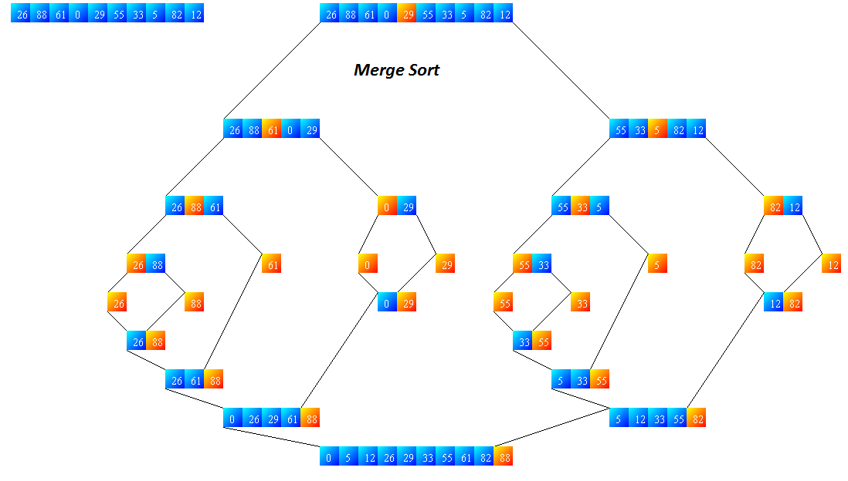
Divide
Divide
Divide
Divide
Divide
Divide
Divide
Divide
Conquer
Divide
Conquer
Conquer
Conquer
Conquer
Conquer
Conquer
Conquer
Conquer

Slide 68
Merge-Sort (A, fst, lst)
INPUT: a sequence of n numbers stored in array A
OUTPUT: an ordered sequence of n numbers
MergeSort (A, fst, lst) // sort A[fst...lst] by divide & conquer
if fst< lst
then mid ← ⎣(fst+lst)/2⎦
MergeSort (A, fst, mid)
MergeSort (A, mid+1, lst)
Merge (A, fst, mid, lst) // merges A[fst..mid] with A[mid+1..lst]
Initial Call: MergeSort(A, 1, n)

Slide 69
Procedure Merge
Merge(A, fst, mid, lst)
1 n₁ ← (mid – fst + 1)
2 n₂ ← (lst – mid)
for i ← 1 to n₁
do L[i] ← A[fst+ i – 1]
for j ← 1 to n₂
do R[j] ← A[mid + j]
L[n₁+1] ← ∞
R[n₂+1] ← ∞
i ← 1
j ← 1
for k ←fst to lst
do if L[i] ≤ R[j]
then A[k] ← L[i]
i ← i + 1
else A[k] ← R[j]
j ← j + 1
Input → Array containing sorted subarrays A[fst...mid] and A[mid+1…lst]
Output → Merged sorted subarray in A[fst...lst]
Sentinels, to avoid having to
check if either subarray is
fully copied at each step.
i
L
n1
j
R
n2
k
A
fst
lst

Slide 70
Merge – Example
A
…
6
8
26
32
1
9
42
43
…
1
6
8
9
26
32
42
43
k
k
k
k
k
k
k
k
k
L
6
8
26
32
∞
R
6
8
26
32
1
9
42
43
∞
1
9
42
43
i
i
i
i
i
j
j
j
j
j

Slide 71
Analysis of Merge Sort
Running time T(n) of Merge Sort:
Divide: computing the middle takes Θ(1)
Conquer: solving 2 subproblems takes 2T(n/2)
Combine: merging n elements takes Θ(n)
Total:
    T(n) = Θ(1) if n = 1
    T(n) = 2T(n/2) + Θ(n) if n > 1
  ⇒ T(n) = Θ(n lg n) (CLRS, Chapter 4)

Slide 72
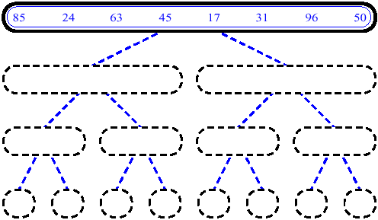
MergeSort (Example) - 1

Slide 73
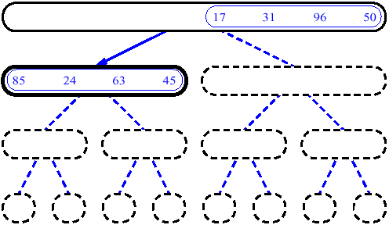
MergeSort (Example) - 2

Slide 74
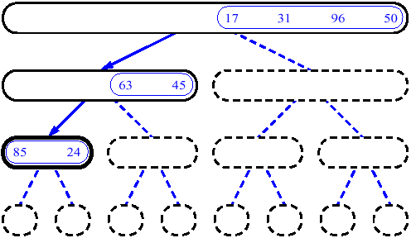
MergeSort (Example) - 3

Slide 75
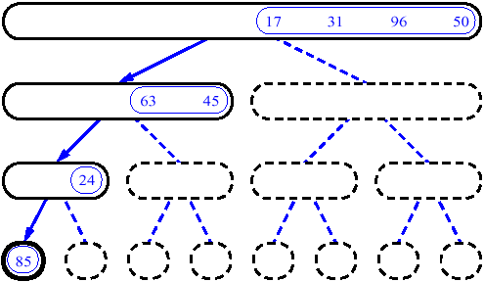
MergeSort (Example) - 4

Slide 76
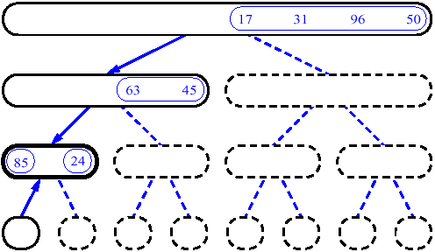
MergeSort (Example) - 5

Slide 77
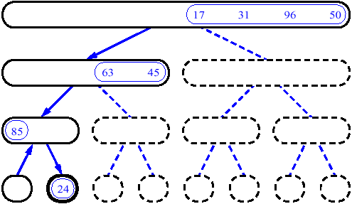
MergeSort (Example) - 6

Slide 78
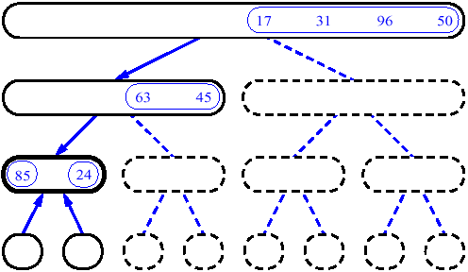
MergeSort (Example) - 7

Slide 79
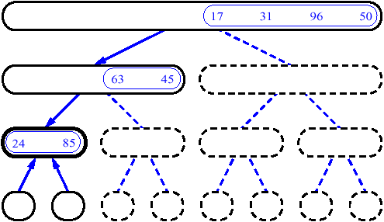
MergeSort (Example) - 8

Slide 80
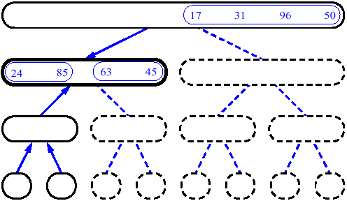
MergeSort (Example) - 9

Slide 81
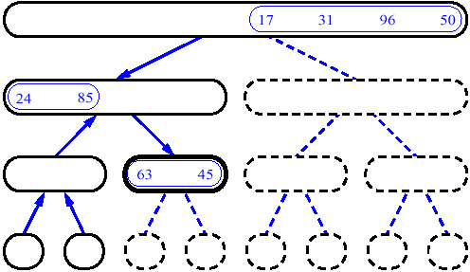
MergeSort (Example) - 10

Slide 82
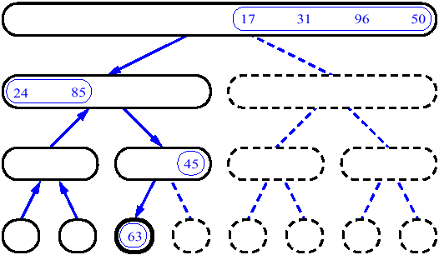
MergeSort (Example) - 11

Slide 83
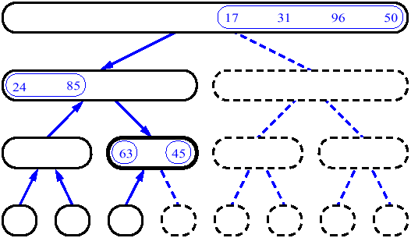
MergeSort (Example) - 12

Slide 84
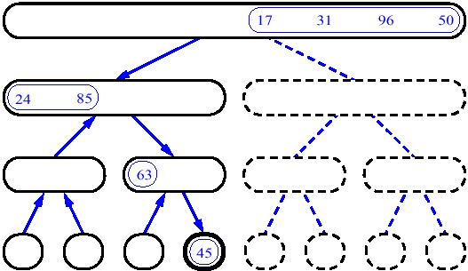
MergeSort (Example) - 13

Slide 85
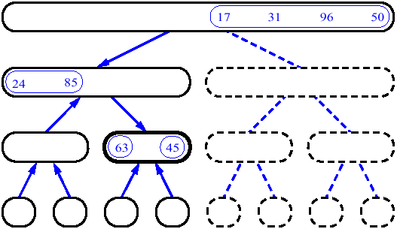
MergeSort (Example) - 14

Slide 86
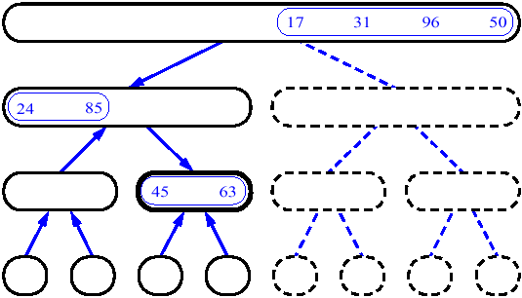
MergeSort (Example) - 15

Slide 87
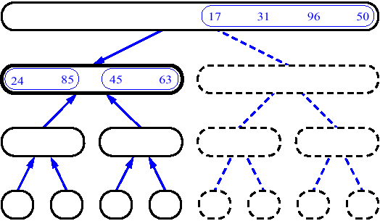
MergeSort (Example) - 16

Slide 88
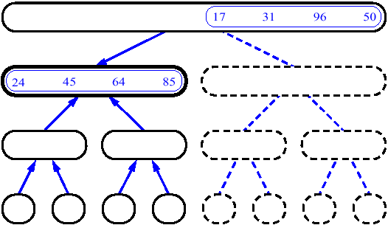
MergeSort (Example) - 17

Slide 89
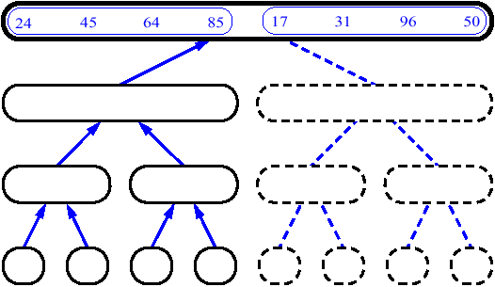
MergeSort (Example) - 18

Slide 90
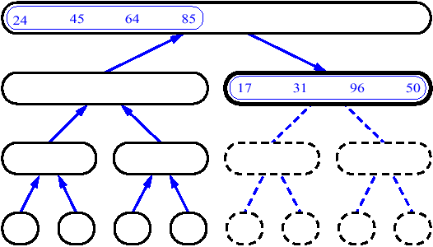
MergeSort (Example) - 19

Slide 91
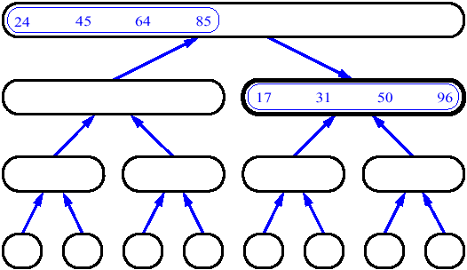
MergeSort (Example) - 20

Slide 92
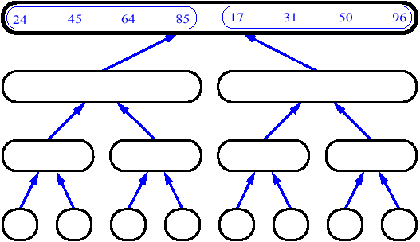
MergeSort (Example) - 21

Slide 93
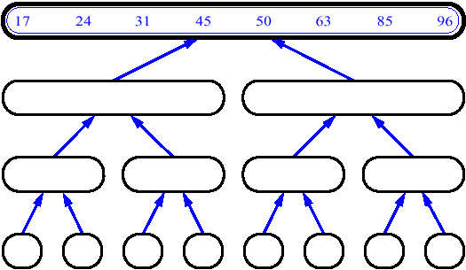
MergeSort (Example) - 22

Slide 94
COMPLEXITY ANALYSIS
SORT | WORST CASE | AVERAGE CASE | BEST CASE
BUBBLE SORT | O(n²) | O(n²) | O(n²)
SELECTION SORT | O(n²) | O(n²) | O(n²)
INSERTION SORT | O(n²) | O(n²) | O(n)
MERGE SORT | O(n log n) | O(n log n) | O(n log n)
QUICK SORT | O(n²) | O(n log n) | O(n log n)

Slide 95
Tower of Hanoi

Slide 96
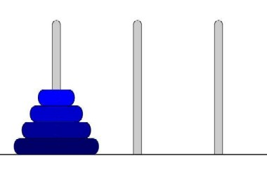
Tower of Hanoi
Tower of Hanoi is a mathematical puzzle invented by a French Mathematician in 1883.
The game starts by having few discs stacked in increasing order of size. The number of discs can vary, but there are only three pegs.

Slide 97
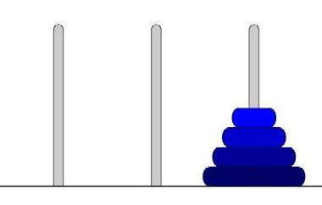
Tower of Hanoi
The Objective is to transfer the entire tower to one of the other pegs. However you can only move one disk at a time and you can never stack a larger disk onto a smaller disk. Try to solve it in fewest possible moves.

Slide 98
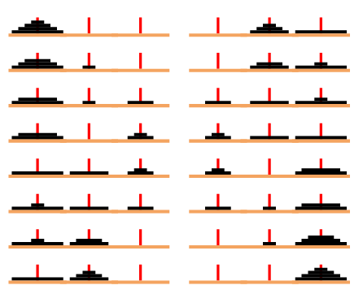
Tower of Hanoi
How to solve the 4 discs

Slide 99
Tower of Hanoi
Recursive Solution for the Tower of Hanoi with algorithm.
Let’s call the three peg Src(Source), Aux(Auxiliary) and Dst(Destination).
  Move the top N – 1 disks from the Source to Auxiliary tower.
  Move the Nth disk from Source to Destination tower.
  Move the N – 1 disks from Auxiliary tower to Destination tower. Transferring the top N – 1 disks from Source to Auxiliary tower can again be thought of as a fresh problem and can be solved in the same manner.

Slide 100
Tower of Hanoi: Algo
TOWER(N, BEG, AUX, END)
If N = 1 then
  Write BEG --> END
  Return
[Move N-1 disks from peg BEG to peg AUX]
  Call TOWER(N-1, BEG, END, AUX)
Write BEG --> END
[Move N-1 disks from peg AUX to peg END]
  Call TOWER(N-1, AUX, BEG, END)
Return.

Slide 101
Tower of Hanoi
For N = 4 we get the following sequence
1. Move from Src to Aux
2. Move from Src to Dst
3. Move from Aux to Dst
4. Move from Src to Aux
5. Move from Dst to Src
6. Move from Dst to Aux
7. Move from Src to Aux
8. Move from Src to Dst
9. Move from Aux to Dst
10. Move from Aux to Src
11. Move from Dst to Src
12. Move from Aux to Dst
13. Move from Src to Aux
14. Move from Src to Dst
15. Move from Aux to Dst

Slide 102
Tower of Hanoi
How many moves will it take to transfer n disks from the left post to the right post?
for 1 disk it takes 1 move to transfer 1 disk from post A to post C;
for 2 disks, it will take 3 moves: 2M + 1 = 2(1) + 1 = 3
for 3 disks, it will take 7 moves: 2M + 1 = 2(3) + 1 = 7
for 4 disks, it will take 15 moves: 2M + 1 = 2(7) + 1 = 15
for 5 disks, it will take 31 moves: 2M + 1 = 2(15) + 1 = 31
for 6 disks... ?

Slide 103
Tower of Hanoi
Explicit Pattern
Number of Disks Number of Moves
1 1
2 3
3 7
4 15
5 31
Powers of two help reveal the pattern:
Number of Disks (n) Number of Moves
1 2^1 - 1 = 2 - 1 = 1
2 2^2 - 1 = 4 - 1 = 3
3 2^3 - 1 = 8 - 1 = 7
4 2^4 - 1 = 16 - 1 = 15
5 2^5 - 1 = 32 - 1 = 31

Slide 104
#include <stdio.h>
void towers(int, char, char, char);
int main()
{
int num;
printf("Enter the number of disks : ");
scanf("%d", &num);
printf("The sequence of moves are :\n");
towers(num, 'A', 'C', 'B');
return 0;
}
void towers(int num, char BEG, char END, char AUX)
{
if (num == 1)
{
printf("\n Move disk 1 from peg %c to peg %c", BEG, END);
return;
}
towers(num - 1, BEG, AUX, END);
printf("\n Move disk %d from peg %c to peg %c", num, BEG, END);
towers(num - 1, AUX, END, BEG);
}

